Slide 1

Department of Computer Science and Engineering
Development of a Personal Virtual Assistant for Windows
GUIDED BY
Dr.R.Palson Kennedy
Principal
SUBMITTED BY
Archana . B - 411521104007
﻿Lakshmi Priya . M - 411521104059
18/02/2025
1
Notes:
1.7.2013
1
Department of Computer Science and Engineering
‹#›

Slide 2
ABSTRACT
Nexus is a Windows-based virtual assistant inspired by Cortana and Siri. Designed for seamless user interaction, it executes tasks via voice commands or keyboard input. The assistant integrates speech recognition, natural language understanding, and task execution to enhance efficiency. Built entirely in Python, it advances human-computer interaction by providing an intuitive and intelligent desktop assistant, streamlining everyday computing for improved productivity and convenience.
18/02/2025
2
Notes:
1.7.2013
2
Department of Computer Science and Engineering
‹#›

Slide 3
SCOPE
An AI desktop virtual assistant leverages artificial intelligence and natural language processing to interact with users, automate tasks, and enhance productivity. It performs functions like scheduling, web searches, email and message handling, and smart device control through voice or text commands. Built using Python, it utilizes speech recognition and machine learning to improve over time. With capabilities like opening applications, fetching information, and reducing manual effort, this assistant streamlines daily computing tasks, making it a valuable tool for both personal and professional use.
18/02/2025
3
Notes:
1.7.2013
3
‹#›

Slide 4
LITERATURE REVIEW
TITLE | YEAR/JOURNAL | METHODOLOGY | DRAWBACKS
Study of Voice Controlled Personal Assistant Device . | International Journal of Computer Trends and Technology (IJCTT) – Volume 42 Number 1 – December 2016 | Uses speech recognition and NLP for command execution. Relies on Google’s speech recognition API for processing. Performs predefined tasks like opening apps, web searches, and reminders. | Limited AI capabilities (no learning or adaptability). Requires an internet connection for functionality. Restricted to predefined commands, reducing flexibility.
AI Based Voice Assistant Using Python | Journal of Emerging Technologies and Innovative Research (JETIR), February 2019, Volume 6 | Utilizes Python libraries (SpeechRecognition, pyttsx3, Wikipedia API) Performs tasks like messaging, music playback, app control, and web searches. | Weak NLP capabilities, struggles with complex queries. No deep learning integration for better context understanding.
18/02/2025
4
Notes:
1.7.2013
4
Department of Computer Science and Engineering
‹#›

Slide 5
SUMMARY OF THE LITERATURE REVIEW
The survey examines AI-driven virtual assistants, focusing on voice-controlled assistants and Python-based AI assistants. The 2016 study uses Google’s Speech API but lacks adaptability and offline support. The 2019 study integrates machine learning for better automation but struggles with complex NLP and multi-user support. Both highlight AI’s role in enhancing productivity, though improvements in NLP, deep learning, and adaptability are needed for smarter virtual assistants.
18/02/2025
5

Slide 6
PROJECT OUTCOME
The AI desktop assistant enhances productivity by automating tasks like managing emails, scheduling, and system controls with voice commands. It is highly personalizable, capable of multitasking, and accessible for users with disabilities. Future developments focus on improving NLP, integration with other technologies, and increased automation, enabling smarter, more efficient interactions. As it learns and adapts, the assistant will provide more personalized experiences and expand its capabilities, transforming daily task management and user interaction with technology.
18/02/2025
6
Notes:
1.7.2013
8
‹#›

Slide 7
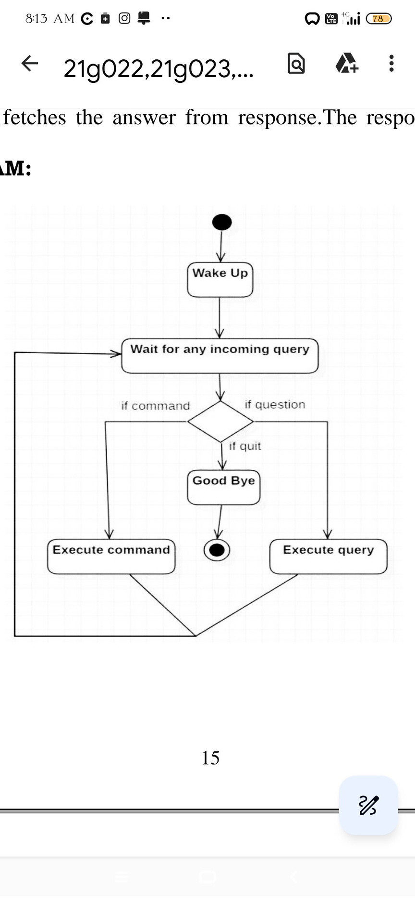
WORKING FLOWCHART
18/02/2025
7
Notes:
1.7.2013
5
‹#›

Slide 8
THANK YOU
18/02/2025
8
Notes:
1.7.2013
11
‹#›

